Slide 1
Knowledge Distillation
Jiyun Kim
Department of Computer Engineering
Source: Prof. Song Han at MIT, Lecture Slide on TinyML and Efficient Deep Learning Computing

Slide 2


Knowledge Distillation
Today we will:
What is knowledge distillation;
What to match;
Self and online distillation;
MIT 6.5940: TinyML and Eﬃcient Deep Learning Computing
2

Slide 3

Tiny models are hard to train
Tiny models underfit large datasets
Training curve for ResNet50 Training curve for MobileNetV2-Tiny
Train. Acc. Val. Acc. Train. Acc. Val. Acc.
82 52
50
79
48
76
46
73
44
70
42
100 110 120 130 140 150
50 60 70 80 90 100
Question: Can we help the training of tiny models with large models?
Network Augmentation for Tiny Deep Learning [Cai et al., ICLR 2022]
MIT 6.5940: TinyML and Eﬃcient Deep Learning Computing
3

Slide 4
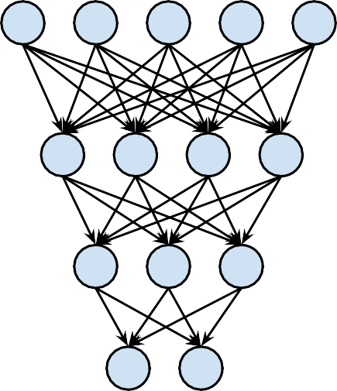



Illustration of knowledge distillation
Logits
Teacher Network
Distillation Loss
Input
Logits
Student Network
Classification Loss
Distilling the Knowledge in a Neural Network [Hinton et al., NeurIPS Workshops 2014]
MIT 6.5940: TinyML and Eﬃcient Deep Learning Computing

Slide 5

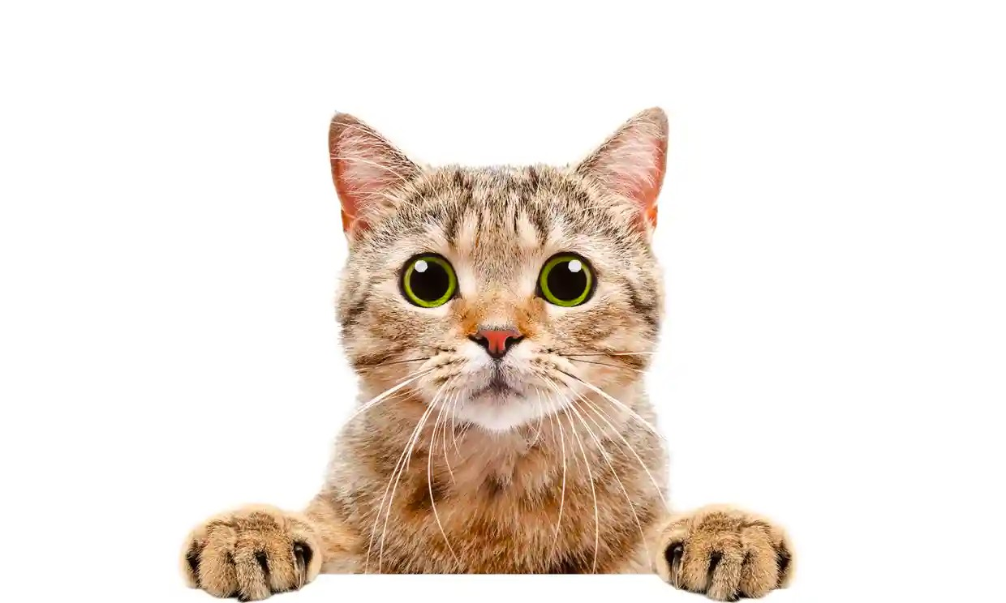

Intuition of knowledge distillation
Matching prediction probabilities between teacher and student
 | Logits | Probabilities
Cat | 5 | 0.982
Dog | 1 | 0.017
exp(5) exp(5) + exp(1)
exp(1) exp(5) + exp(1)
Teacher Network
 | Logits | Probabilities
Cat | 3 | 0.731
Dog | 2 | 0.269
The student model is less confident
Student Network
MIT 6.5940: TinyML and Eﬃcient Deep Learning Computing

Slide 6
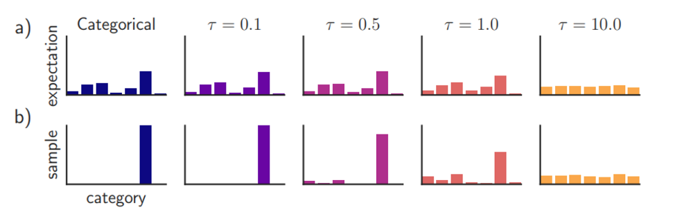
Temperature
Temperature의 변화에 따른 SoftMax의 확률값 분포를 나타냄

Slide 7

Intuition of knowledge distillation
Concept of temperature
exp(5/1) exp(5/1) + exp(1/1)
 | Logits | Probabilities (T=1) | Probabilities (T=10)
Cat | 5 | 0.982 | 0.599
Dog | 1 | 0.017 | 0.401
Teacher Network
exp(5/10) exp(5/10) + exp(1/10)
A larger temperature smooths the output probability distribution.
MIT 6.5940: TinyML and Eﬃcient Deep Learning Computing

Slide 8
What to match?
Output logits
Intermediate weights
Intermediate features
Gradients
MIT 6.5940: TinyML and Eﬃcient Deep Learning Computing

Slide 9
Matching output logits
Teacher Model
Layer 1
Layer 2
…
Layer N
Logits
Input
Distillation Loss
Layer 1
Layer 2
Layer N
Logits
…
Student Model
Classification Loss
Distilling the Knowledge in a Neural Network [Hinton et al., NeurIPS Workshops 2014] Do Deep Nets Really Need to be Deep? [Ba and Caruana, NeurIPS 2014]
MIT 6.5940: TinyML and Eﬃcient Deep Learning Computing

Slide 10

What else to match other than output logits?
Matching intermediate weights
Teacher Model
Layer 1
Layer 2
…
Layer N
Logits
Input
Distillation Loss
Layer 1
Layer 2
Layer N
Logits
…
Student Model
Classification Loss
Knowledge Distillation: A Survey [Gou et al., IJCV 2020]
MIT 6.5940: TinyML and Eﬃcient Deep Learning Computing

Slide 11

Matching intermediate weights
Teacher Network
FitNet
W_{S}
M
.
.
.
W_{T}
L
.
.
.
W
W
*
Guided
=
^{(W}Guided^{, W}r⁾
W_{T}
S
_{W} g
An FC layer used to align the shapes of teacher and student weights
_{W} h
S
W_{r}
T
.
.
.
.
W
W
Guided.
.
Hint
^{W}Hint
W
_{W} 2
Guided
T
_{W} 2
_{W} 1
S
T
W_{S}
1
(a) Teacher and Student Networks (b) Hints Training
Other than the cross-entropy distillation loss, also add a L2 loss between teacher weights and student weights (linear transformation is applied to match the dimensionalities).
•
FitNets: Hints for Thin Deep Nets [Romero et al., ICLR 2015]
MIT 6.5940: TinyML and Eﬃcient Deep Learning Computing

Slide 12
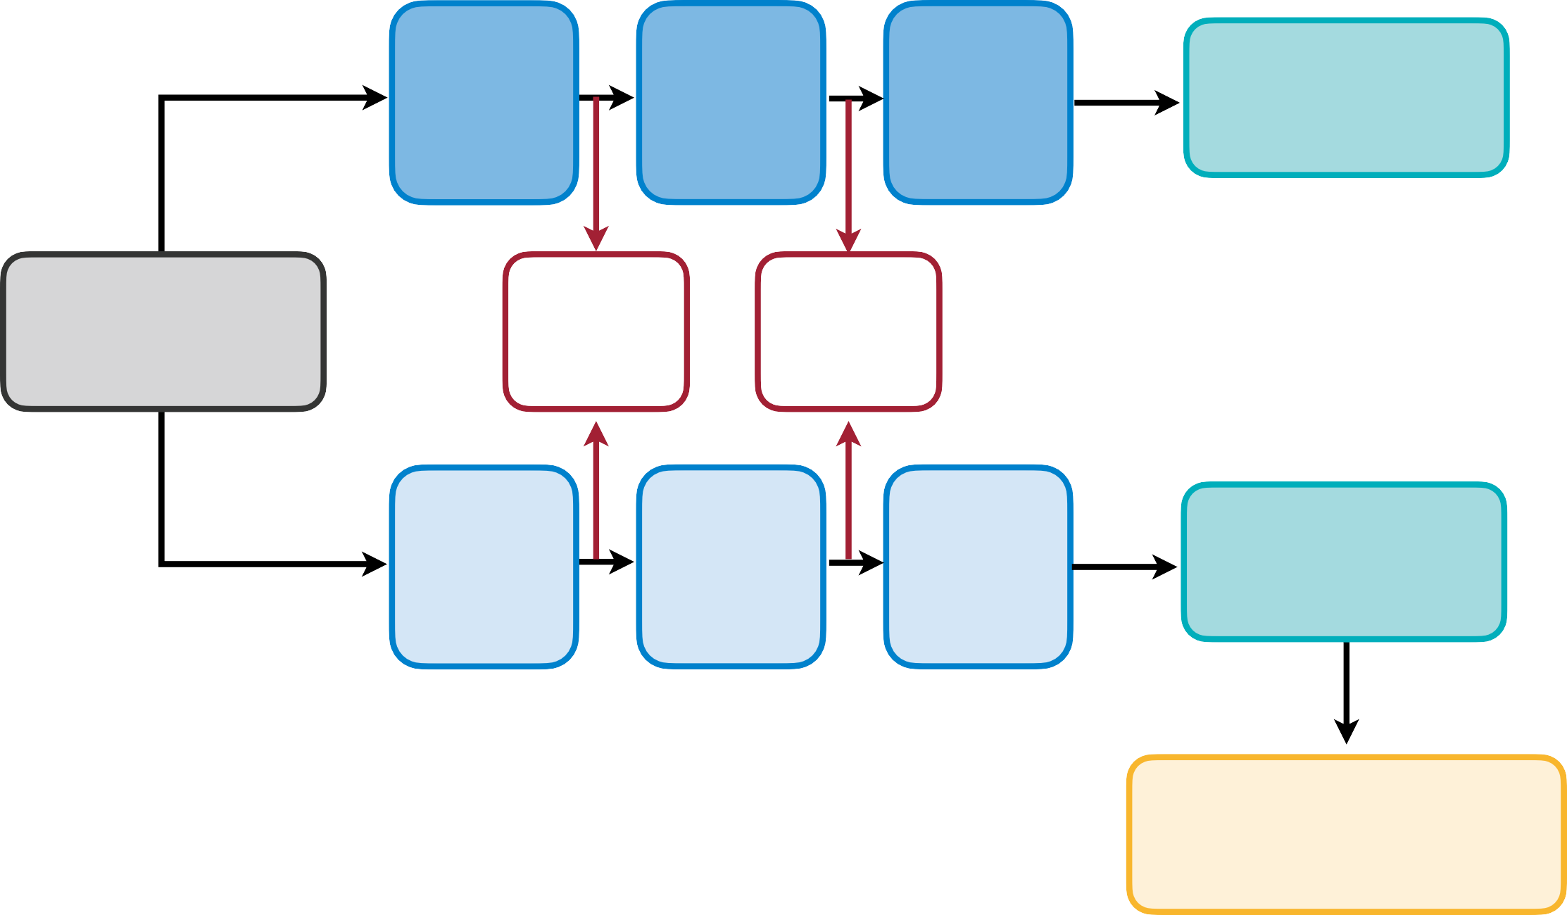
Matching intermediate features
Minimizing maximum mean discrepancy between feature maps
Intuition: teacher and student networks should have similar feature distributions, not just output probability distributions.
Teacher Model
Layer 1
Layer 2
…
Layer N
Logits
Input
KD
Loss
KD
Loss
Match intermediate feature maps
Layer 1
Layer 2
Layer N
Logits
…
Student Model
Classification Loss
Like What You Like: Knowledge Distill via Neuron Selectivity Transfer [Huang and Wang, arXiv 2017]
MIT 6.5940: TinyML and Eﬃcient Deep Learning Computing

Slide 13










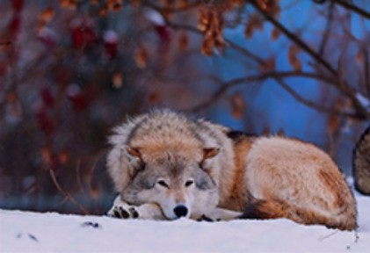
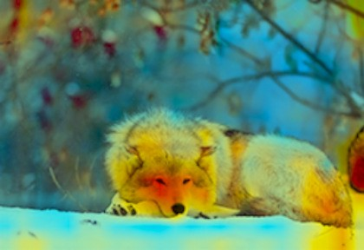
Intermediate attention maps
Gradients of feature maps are used to characterize “attention” of DNNs
The attention of a CNN feature map
is defined as ^{∂L} , where
is the learning objective.
∂x
∂L
Intuition: If
is large, a small perturbation at i, j will significantly impact the final output. As a
•
∂x
i,j
result, the network is putting more attention on position i, j.
Paying More Attention to Attention: Improving the Performance of Convolutional Neural Networks via Attention Transfer [Zagoruyko and Komodakis, ICLR 2017]
MIT 6.5940: TinyML and Eﬃcient Deep Learning Computing

Slide 14


























Intermediate attention maps
Performant models have similar attention maps
Attention maps of performant ImageNet models (ResNets) are indeed similar to each other, but the less performant model (NIN) has quite different attention maps.
NIN
(62% acc)
ResNet34 (73% acc)
ResNet101 (77% acc)
Input
^{F}sum
^{F}s² um
^{F}s⁴ um
^{F}m² ax
^{F}sum
^{F}s² um
^{F}s⁴ um
^{F}m² ax
Different reduction methods across the channel dimensions
Paying More Attention to Attention: Improving the Performance of Convolutional Neural Networks via Attention Transfer [Zagoruyko and Komodakis, ICLR 2017]
MIT 6.5940: TinyML and Eﬃcient Deep Learning Computing

Slide 15
Matching intermediate attention maps
Teacher Model
Layer 1
Layer 2
…
Layer N
Logits
KD
Loss
KD
Loss
∂L
Match intermediate attention maps
Input
∂x
Layer 1
Layer 2
Layer N
Logits
…
Student Model
Classification Loss
Paying More Attention to Attention: Improving the Performance of Convolutional Neural Networks via Attention Transfer [Zagoruyko and Komodakis, ICLR 2017]
MIT 6.5940: TinyML and Eﬃcient Deep Learning Computing

Slide 16
Self and Online Distillation
Self Distillation
Online Distillation
Combined
MIT 6.5940: TinyML and Eﬃcient Deep Learning Computing

Slide 17
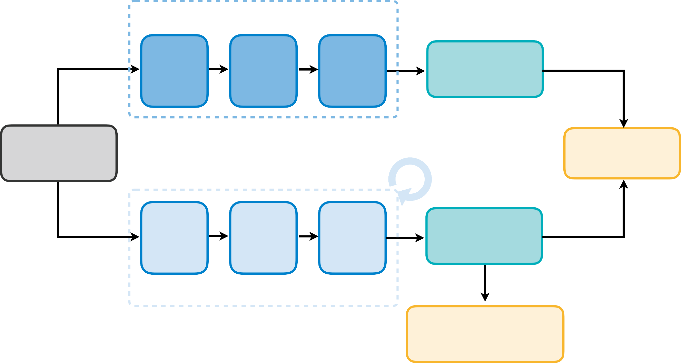
Overview of knowledge distillation
Teacher model is usually larger than the student model and is fixed
Teacher Model: Large, Fixed
Layer 1
Layer 2
…
Layer N
Logits
Input
Distillation Loss
Layer 1
Layer 2
…
Layer N
Logits
Student Model: Small
Classification Loss
Discussion: What is the disadvantage of fixed large teachers? Does it have to be the case that we need a fixed large teacher in KD?
Knowledge Distillation: A Survey [Gou et al., IJCV 2020]
MIT 6.5940: TinyML and Eﬃcient Deep Learning Computing

Slide 18
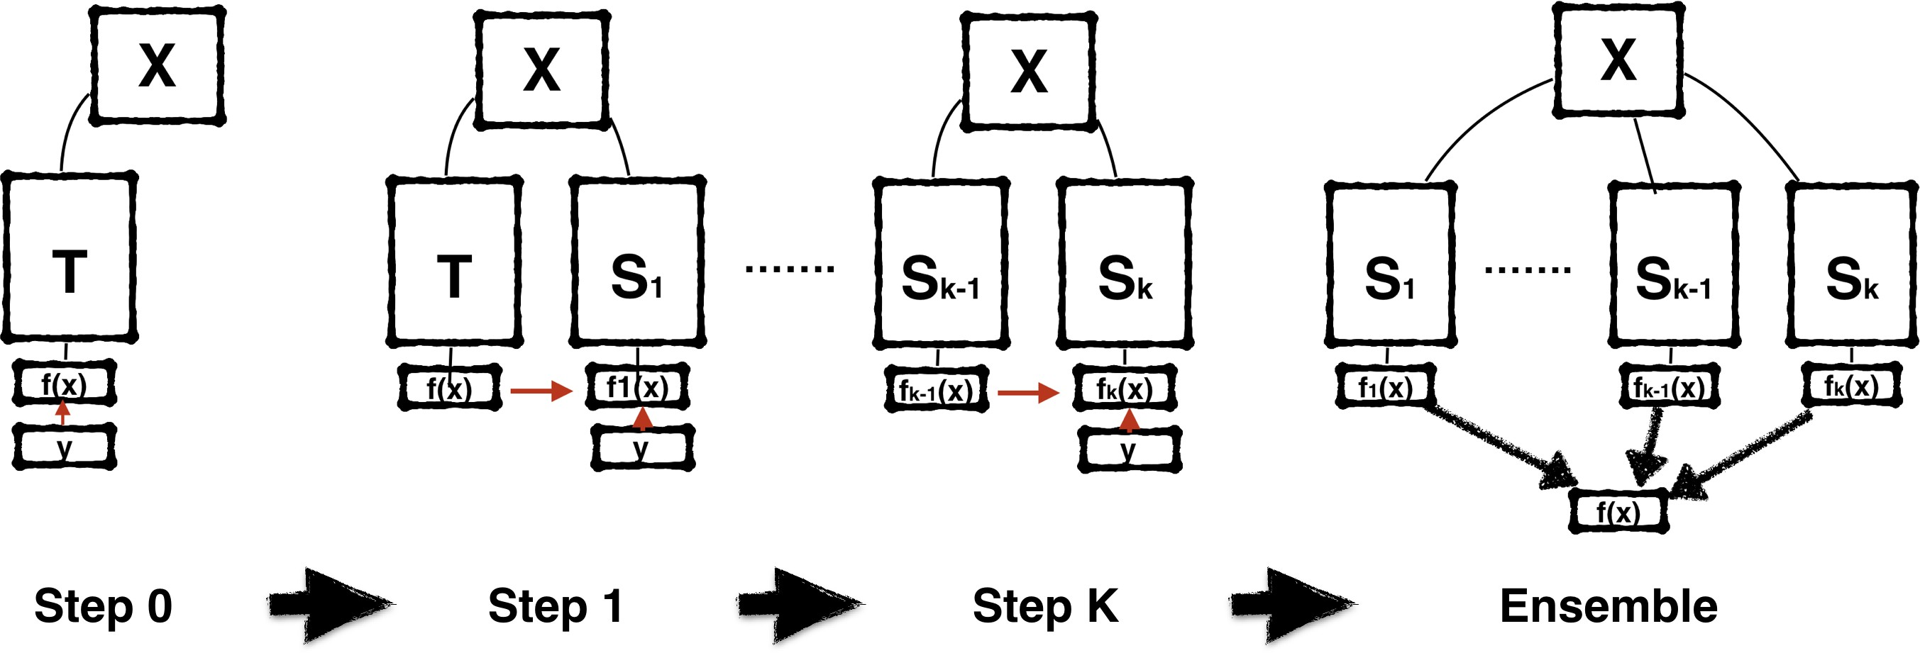
Self-Distillation with Born-Again NNs
•
Born-Again Networks adds iterative training stages and using both classification objective and distillation objective in subsequent stages.
Network architecture T = S₁ = S₂ = . . . = S_{k}. Network accuracy T < S₁ < S₂ < . . . < S_{k}.
Can alternatively ensemble T, S₁, S₂, . . . , S_{k} to get even better performance.
Born-Again Neural Networks [Furlanello et al., ICML 2018]
•
•
•
MIT 6.5940: TinyML and Eﬃcient Deep Learning Computing

Slide 19
Self and Online Distillation
Self Distillation
Online Distillation
Combined
MIT 6.5940: TinyML and Eﬃcient Deep Learning Computing

Slide 20
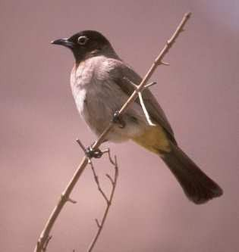
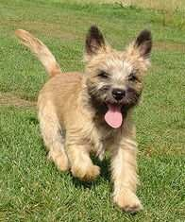
Online Distillation
Deep Mutual Learning
Θ₁, Θ₂ can be the same or different, and they are trained from scratch.
Logits Predictions labels
Network Θ₁
𝑧₁ 𝑝₁
^{𝐿}𝐶1
…
KL(p2||p1)
KL(p1||p2)
𝑧₂
𝑝₂
^{𝐿}𝐶2
Network Θ₂
Idea of deep mutual learning: for both teacher and student networks, we want to add a distillation objective that minimizes the output distribution of the other party.
ℒ(S) = CrossEntropy(S(I), y) + KL(S(I), T(I));
ℒ(T ) = CrossEntropy(T(I), y) + KL(T(I), S(I)).
Note: it is not necessary to pretrain T and
S = T is allowed.
Deep Mutual Learning [Zhang et al., CVPR 2018]
MIT 6.5940: TinyML and Eﬃcient Deep Learning Computing

Slide 21
Online Distillation
Deep Mutual Learning
Network Types |  | CIFAR-10 |  |  |  |  |  | CIFAR-100
 |  | Independent |  | DML |  | DML-Ind |  | Independent |  | DML |  | DML-Ind
Net 1 | Net 2 | Net 1 | Net 2 | Net 1 | Net 2 | Net 1 | Net 2 | Net 1 | Net 2 | Net 1 | Net 2 | Net 1 | Net 2
Resnet-32 | Resnet-32 | 92.47 | 92.47 | 92.68 | 92.80 | 0.21 | 0.33 | 68.99 | 68.99 | 71.19 | 70.75 | 2.20 | 1.76
WRN-28-10 | Resnet-32 | 95.01 | 92.47 | 95.75 | 93.18 | 0.74 | 0.71 | 78.69 | 68.99 | 78.96 | 70.73 | 0.27 | 1.74
MobileNet | Resnet-32 | 93.59 | 92.47 | 94.24 | 93.32 | 0.65 | 0.85 | 73.65 | 68.99 | 76.13 | 71.10 | 2.48 | 2.11
MobileNet | MobileNet | 93.59 | 93.59 | 94.10 | 94.30 | 0.51 | 0.71 | 73.65 | 73.65 | 76.21 | 76.10 | 2.56 | 2.45
WRN-28-10 | MobileNet | 95.01 | 93.59 | 95.73 | 94.37 | 0.72 | 0.78 | 78.69 | 73.65 | 80.28 | 77.39 | 1.59 | 3.74
WRN-28-10 | WRN-28-10 | 95.01 | 95.01 | 95.66 | 95.63 | 0.65 | 0.62 | 78.69 | 78.69 | 80.28 | 80.08 | 1.59 | 1.39
Deep mutual learning can improve both student (net 2) and teacher (net 1) models.
Deep Mutual Learning [Zhang et al., CVPR 2018]
MIT 6.5940: TinyML and Eﬃcient Deep Learning Computing

